Slide 1
Video and Audio
Notes:
HTML5 provides native support for video and audio, via the new <video> and <audio> tags. These are quite straightforward to use, so we can cover this ground quite quickly ☺.

Slide 2
Contents
Playing video
Playing audio
Demos folder:
Demos\10-VideoAudio
Notes:
Section 1 introduces the <video> tag in HTML5, so that you can play videos natively without the need for plugins.
Section 2 does likewise for the <audio> tag in HTML5, so you can play audio clips natively.

Slide 3
1. Playing Video
Overview
Using the <video> tag
Scripting a video
Detecting browser capabilities
Notes:
This section introduces the <video> tag, which allows you to download and play video clips natively in a Web page.

Slide 4
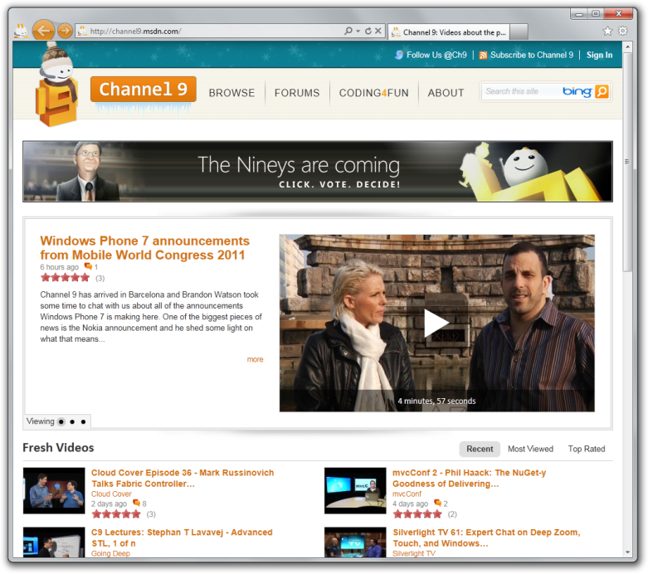
Overview
The HTML5 <video> element provides native support for videos
No need for plug-ins
Videos can be composited with anything else on the page
HTML content, images, canvases, SVG
Ideally you should support the following video formats on your web site:
WebM
MP4
OGV
Notes:
Many of the new features in HTML5 have been driven by the mobile market. In this arena, the inability to play certain types of media on certain types of device has been well documented.
The <video> tag in HTML5 obviates the need for plugins - it allows you to play videos natively in the browser.

Slide 5
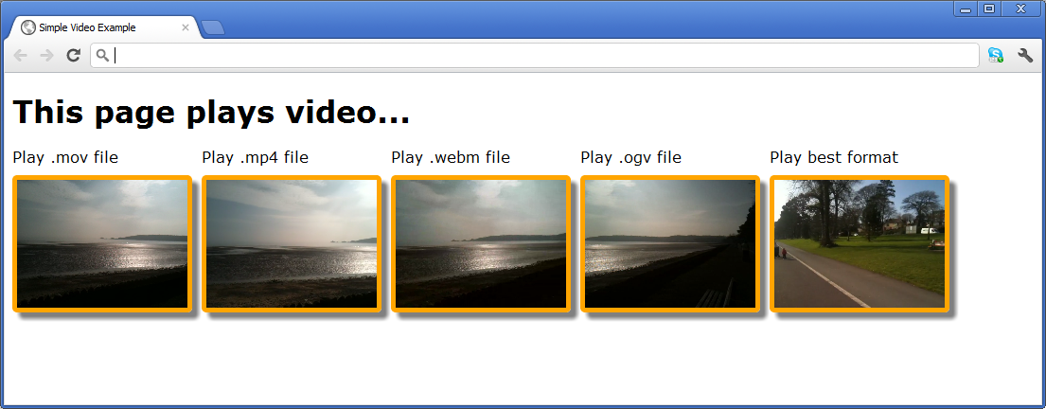
Using the <video> Tag
See Video/PlayVideo.html
<style>
video {
width: 180px;
height: 135px;
…
}
</style>
…
<h1>This page plays video...</h1>
<video src="MyVideos/SwanseaBay.mov" poster="ImageLoading.png"
autoplay loop controls></video>
…
<video poster="ImageLoading.png" controls>
<source src="MyVideos/SwanseaBay.mp4" type='video/mp4' />
<source src="MyVideos/SwanseaBay.webm" type='video/webm' />
<source src="MyVideos/SwanseaBay.ogv" type='video/ogg' />
<!-- You can embed Flash or Silverlight content here, as a fallback -->
<!-- Display some text in case the browser doesn't support the video tag -->
Can't play video. Download video <a href="MyVideos/SwanseaBay.webm">here</a>.
</video>
Notes:
The example in the slide shows how to use the <video> element. Run the example to see how it works. The example shows various clips of Swansea bay in Wales, on a (reasonably) sunny Spring morning.
Note there are two ways to specify the video you want to play:
Either: Set the src attribute in the <video> tag, to indicate the video file you want to play.
Or: Define one or more <source> child elements within the <video> tag. This approach is generally preferred, because it allows you to support multiple video file formats (e.g. MP4, WEBM, etc.). It also allows you to provide alternative content types such as Flash or Silverlight.

Slide 6
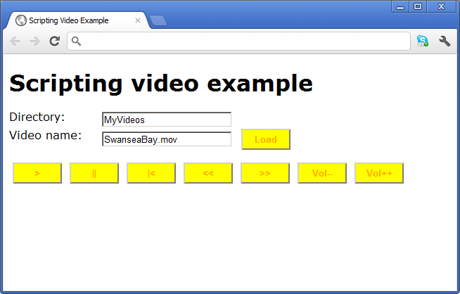
Scripting Video
The <video> element has events, methods and properties that you can access in JavaScript
See Video/ScriptVideo.html
var newVideo = document.createElement("video");
newVideo.src = videoDirElem.value + "/" + videoNameElem.value;
newVideo.loop = true;
newVideo.autoplay = true;
newVideo.controls = true;
newVideo.poster = "ImageLoading.png";
…
aVideo.play();
aVideo.pause();
…
aVideo.currentTime = 0;
aVideo.playbackRate = 3;
aVideo.volume += 0.25;
Notes:
You can create video objects dynamically and add them to the DOM tree as needed. You can then set properties and invoke methods on the video object, to control video playback.
The example in the slide shows how to do all this.

Slide 7
Detecting Browser Capabilities
You can detect whether the browser supports <video>
try
{
var v = document.createElement("video");
if (v && v.canPlayType &&
v.canPlayType("video/mp4").match(/^(probably|maybe)$/i))
{
// Browser can likely play MPEG-4 video
}
else
{
// Browser cannot play MPEG-4 video
}
}
catch (e)
{
// Exception when testing for MPEG-4 Playback
}
Notes:
On the subject of creating video objects programmatically, you can also detect the browser's video capabilities as shown here. The video object (and the audio object - see later) has a canPlayType() method that indicates whether the browser is capable of playing a particular video/audio type.The canPlayType() method can return one of the following values:
"probably" - The browser probably supports this video/audio type.
"maybe" - The browser might support this video/audio type.
"" - The browser does not support this video/audio type.

Slide 8
2. Playing Audio
Overview
Using the <audio> tag
Scripting audio
Detecting browser capabilities
Notes:
This section introduces the <audio> tag, which allows you to download and play audio clips natively in a Web page.

Slide 9
Overview
The HTML5 <audio> element provides native support for playing audios
No need for plug-ins
Audios are fully scriptable
By using DOM
The current specification does not specify which audio formats browsers should support
Notes:
The <audio> element is very similar to <video>. It has many of the same attributes and child elements, and has a similar programming model.

Slide 10
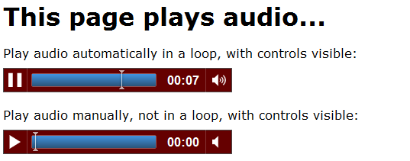
Using the <audio> Tag
See Audio/PlayAudio.html
<style>
audio {
margin-top: 10px;
background-color: red;
}
…
</style>
…
<h1>This page plays audio...</h1>
Play audio automatically in a loop, with controls visible:<br/>
<audio src="MyAudios/Beat.mp3" autoplay loop controls></audio> <br/><br/>
Play audio manually, not in a loop, with controls visible:<br/>
<audio src="MyAudios/Beat.mp3" controls></audio> <br/><br/>
Notes:
The example in the slide shows how to use the <audio> element. Run the example to see how it works.
The first <audio> element plays as soon as the page is loaded, and loops continuously.
The second <audio> element doesn't play automatically - you have to click the Play button. Also, the audio doesn’t loop continuously.

Slide 11
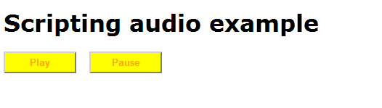
Scripting Audio
<audio> has events, methods and properties that you can access in JavaScript
See Audio/ScriptAudio.html
var audio = document.createElement("audio");
audio.addEventListener('ended', function () {
doPlay();
}, false);
function doPlay() {
audio.src = anAudioFile;
audio.play();
}
function doPause() {
audio.pause();
}
Notes:
You can create audio objects dynamically and add them to the DOM tree, just as we did for video objects earlier in the chapter.
Note: The World Wide Web Consortium (W3C) are also working on an enhanced Web Audio API that provides much greater control over audio playback. For more information, see:
http://www.w3.org/TR/webaudio/

Slide 12
Detecting Browser Capabilities
You can detect whether the browser supports <audio>
See Audio/BrowserDetection.html
var audio = document.createElement("audio");
if (audio && audio.canPlayType &&
audio.canPlayType("audio/mp3"))
{
// Browser can play MP3 audio.
}
else
{
// Browser cannot play MP3 audio.
}
Notes:
The audio object has a canPlayType() method, just like for the video element. This allows you to test whether the browser is capable of playing a particular video/audio type.

Slide 13
Any Questions?

